Slide 1

WIRELESS SENSOR
NETWORKS

Slide 2

Meet
THE TEAM : VOID ( )
Farha Islam Jitu
Ismot Ara
Sadiya Islam Mou
ID : 2101023
ID : 2101027
ID : 2101028

Slide 3

Table of contents
01
02
03
04
Basics of WSN
Layered Architecture of WSN
Benifits of WSN
Types of WSN
05
06
07
08
WSN Topologies
Security
Applications
Avantages & Disadvantages

Slide 4

What is WSN ??
An infrastructure-less wireless network, deployed with a large number of lightweight sensor nodes in an ad-hoc manner, which is used to monitor system, physical or environmental conditions.

Slide 5
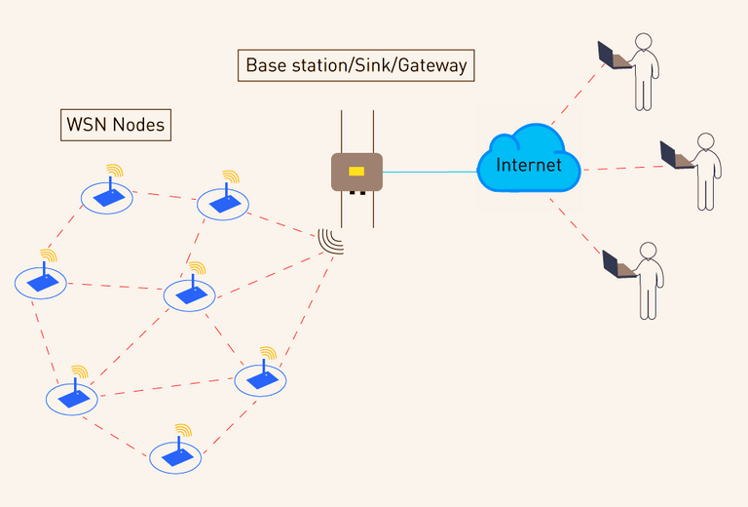
Main Components of WSN
Sensor Nodes:
Perform sensing, data processing, and communication to monitor environmental or system conditions.
Sink / Base Station / Gateway:
Central unit that collects, processes, and manages data from sensor nodes.
Communication Medium:
Wireless protocols (e.g., Bluetooth, Zigbee) facilitate data transmission between sensor nodes and the base station.

Slide 6
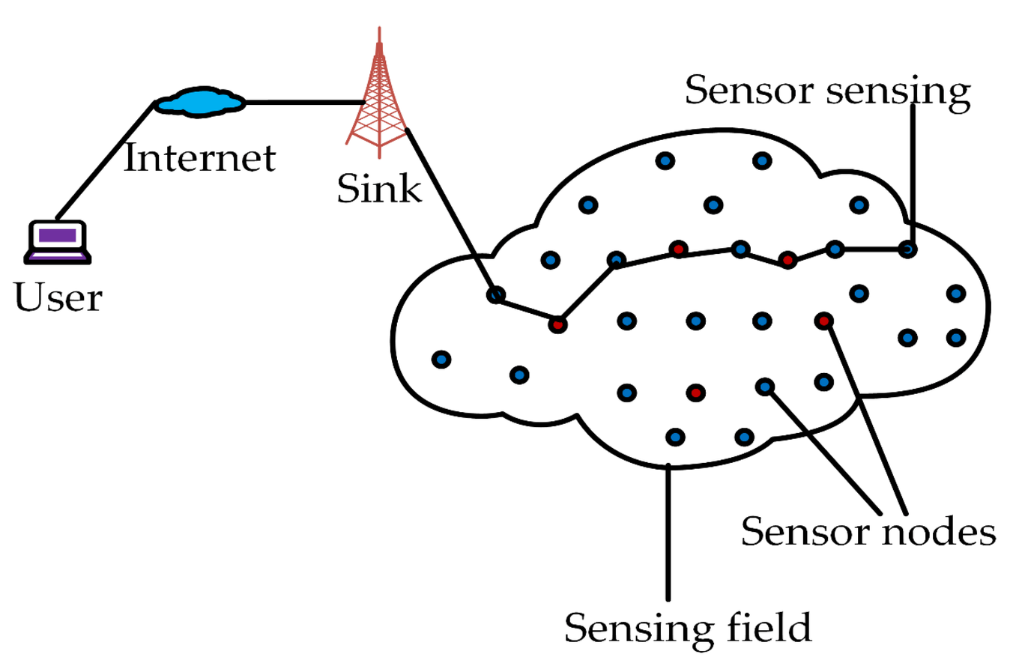
HOW IT BASICALLY WORKS?
Sensor nodes are connected to the Base Station which acts as a processing unit in the WSN System. The base Station in a WSN System is connected through the Internet to share data.

Slide 7
Characteristics of WSN
Energy Efficiency
Use low-power components, communication protocols, and sleep modes to minimize energy consumption for prolonged operation.
Limited Processing and Memory
Sensor nodes have small processors and minimal memory to keep size and cost low, sufficient for basic tasks like sensing and transmission.
Dense Deployment and Multi-Hop Communication
Nodes are placed closely together to cover a large area, and multi-hop communication lets data pass through other nodes, extending the range and saving energy.

Slide 8
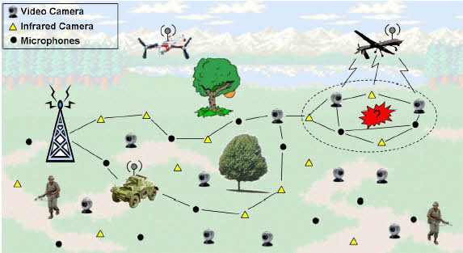
Types of WSN
Terrestrial WSN
Deployed on the ground or Earth's surface to monitor the environmental conditions of an area
Consist of thousands of nodes
Nodes are placed in an ad hoc (random) or structured (planned) manner.
Focus on low energy use and optimal routing for efficiency.

Slide 9
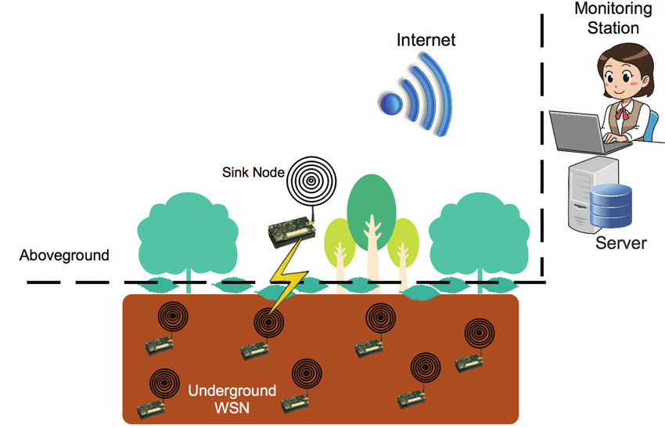
Types of WSN
Underground WSN
Nodes are buried underground to monitor underground conditions.
Require additional sink nodes above ground for data transmission.
Face challenges like high installation and maintenance costs.
Limited battery life and difficulty in recharging due to underground setup.

Slide 10
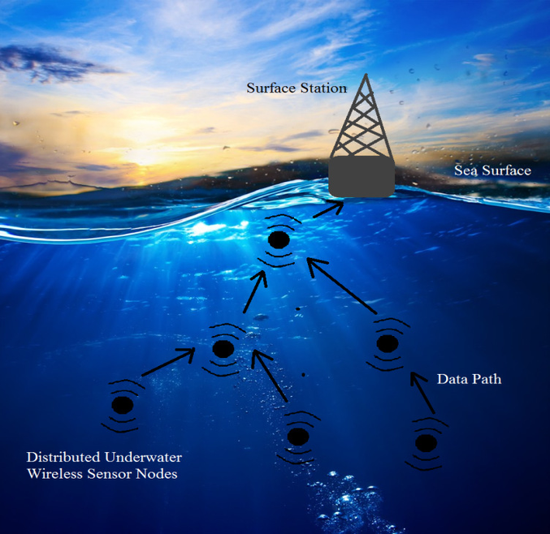
Types of WSN
Underwater WSN
Deployed in water environments using sensor nodes and autonomous underwater vehicles.
Face challenges like slow data transmission, bandwidth limitations etc.
Nodes have restricted and non-rechargeable power sources.

Slide 11
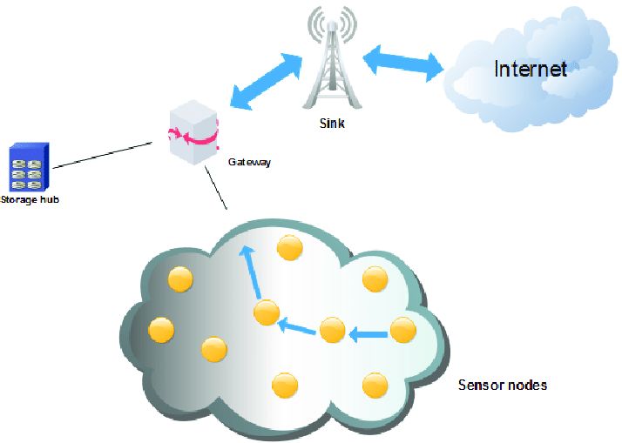
Types of WSN
Multimedia WSN
Used to monitor multimedia events such as video, audio, and images.
Nodes equipped with microphones and cameras for data capture.
Challenges include high power consumption, large bandwidth requirements, and complex data processing.
Designed for efficient wireless data transmission.

Slide 12
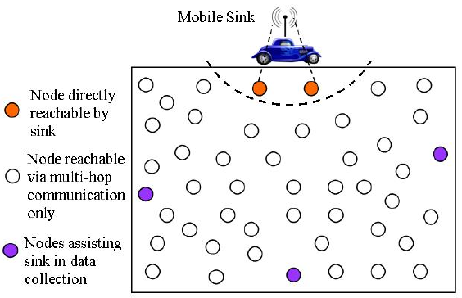
Types of WSN
Mobile WSN
Composed of mobile sensor nodes capable of independent movement.
Offer advantages like increased coverage area, energy efficiency, and channel capacity compared to static networks.
Nodes can sense, compute, and communicate while moving in the environment.

Slide 13
The architecture used in WSN is sensor network architecture. This kind of architecture is applicable in different places such as hospitals, schools, roads, buildings as well as it is used in different applications such as security management, disaster management & crisis management, etc. There are two types of architectures used in wireless sensor networks.
WSN Architectures
Layered Network Architecture
Clustered Network Architecture

Slide 14
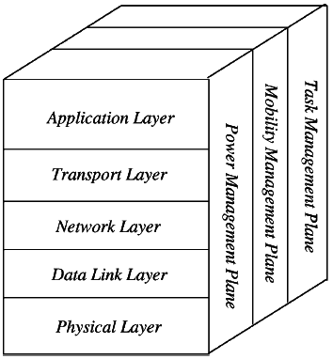
01
Follows the OSI architecture Model
WSN Architecture ( Layered)
02
The architecture of the WSN includes five layers and three cross layers.
03
This kind of network uses hundreds of sensor nodes as well as a base station.
04
Three cross layers are mainly used for controlling the network as well as to make the sensors function as one in order to enhance the overall network efficiency.

Slide 15

Application Layer
Liable for traffic management
Offers software for numerous applications
5 LAYERS OF WSN
Agricultural, military, environment, medical, etc.
Transport Layer
Deliver congestion avoidance and reliability.
The transport layer is exactly needed when a system is planned to contact other networks.
Packet driven, Event-driven.
Some popular protocols in the transport layer namely STCP (Sensor Transmission Control Protocol), PORT (Price-Oriented Reliable Transport Protocol and PSFQ (pump slow fetch quick).

Slide 16
Network Layer
The main function of the network layer is routing,
TIME-DRIVEN, QUERY-DRIVEN & EVENT-DRIVEN.
Protocols for this network layer, they can be separated into; flat routing and hierarchal routing
5 LAYERS OF WSN
Data Link Layer
Responsible for establishing a reliable connection between sensor nodes and the base station.
It uses protocols such as IEEE 802.15.4 to manage data transmission and ensure efficient communication within the network.

Slide 17
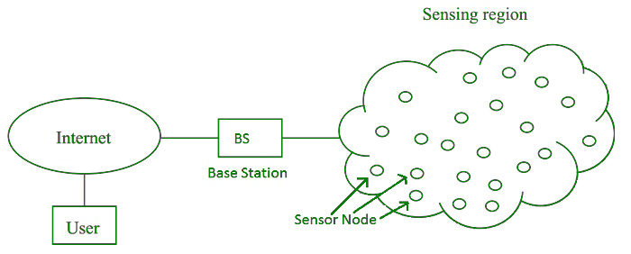
5 LAYERS OF WSN
Physical Layer
This layer connects sensor nodes to the base station using technologies like radio waves, infrared, or Bluetooth.
It ensures the physical communication between nodes and the base station.

Slide 18
BENEFITS
01
02
Low - power transmissions to the neighboring nodes
LESS-DISTANCE
03
SCALABLE
04
HIGH FAULT TOLERANCE

Slide 19
Real-Life Example of WSN Architecture: Smart Agriculture System
Scenario:
Imagine a smart farm that uses wireless sensor networks to monitor soil moisture, temperature, and humidity levels to optimize irrigation.
Physical Layer:
Data Link Layer:
Network Layer:
Transport Layer:
Application Layer:
Role: Provides the hardware components and handles the wireless communication signals.
Example: Sensors (soil moisture, temperature, humidity) and actuators send and receive data through wireless signals using technologies like Zigbee or Bluetooth.
Role: Ensures error-free data transfer and manages access to the shared wireless channel.
Example: If multiple sensors send data at the same time, the Data Link Layer ensures they don’t interfere by using mechanisms like TDMA (Time Division Multiple Access).
Role: Handles routing of data packets from the sensors to the base station.
Example: The network layer decides the best path for the sensor data to reach the farm’s central monitoring system. In a large farm, data may hop between multiple sensor nodes before reaching the base station.
Role: Ensures reliable delivery of data, especially in larger networks.
Example: If a sensor reading is lost during transmission, the Transport Layer handles retransmission so the base station receives complete information.
Role: Interfaces with the user and provides meaningful data.
Example: Farmers view real-time data on an app or dashboard to decide when and how much to water crops.

Slide 20
Cross-Layers in Action
Power Management Plane:
Mobility Management Plane:
Task Management Plane:
Role: Optimizes battery usage to extend the sensor network’s lifespan.
Example: Sensors enter sleep mode when no readings are needed, conserving energy.
Role: Maintains communication with mobile nodes.
Example: If a sensor is attached to a moving irrigation drone, the Mobility Plane ensures it stays connected to the network.
Role: Assigns tasks efficiently to different nodes.
Example: If multiple sensors detect similar readings (e.g., soil moisture), the Task Plane avoids redundant data collection to save energy.

Slide 21
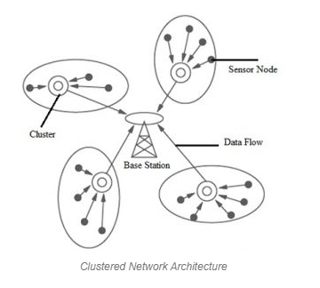
Clustered Network Architecture
In this kind of architecture, separately sensor nodes add into groups known as clusters which depend on the “Leach Protocol” because it uses clusters. The term ‘Leach Protocol’ stands for “Low Energy Adaptive Clustering Hierarchy”.

Slide 22
This kind of network architecture is extremely used due to the data fusion property.
In every cluster, every node can interact through the head of the cluster to get the data.
All the clusters will share their collected data toward the base station.
The formation of a cluster, as well as its head selection in each cluster, is an independent as well as autonomous distributed method.
Clustered Network Architecture

Slide 23
BENEFITS Of this ARCHITECTURE
1
2
3
Energy Efficiency
Only the cluster head communicates with the base station, minimizing the power used by individual sensor nodes.
SCALABILITY
New (nodes) can be added to the network easily by assigning them to the nearest cluster.
Reduced Data Traffic
Instead of every NODE transmitting data to the base station, only the cluster head sends a summarized report, reducing congestion.

Slide 24
Energy Consumption
Localization
Coverage
Clocks
Computation
Cost of Production
Design of Hardware
Quality of Service
Design Issues of Wireless Sensor Network Architecture

Slide 25
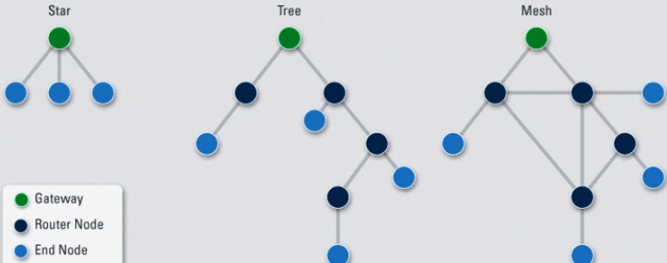
Topology
Topology in WSN refers to the arrangement or organization of sensor nodes and their communication patterns within the network. It defines how nodes are connected and interact to transmit data.

Slide 26
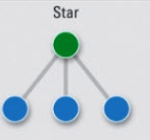
Star Topology
Each node connects directly to a central gateway or hub.
Nodes do not communicate directly with each other.
The gateway manages all communication in the network.
Nodes send and receive messages only via the gateway.
Advantages:
Low latency
Power efficiency
Centralized control
The size of the network depends on the number
of connections the gateway can handle.

Slide 27
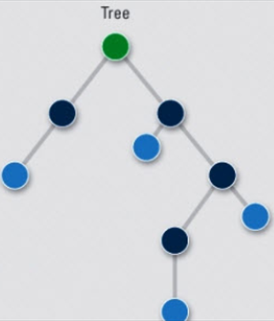
Tree Topology
Also known as cascaded star topology.
Nodes are organized in a hierarchical structure resembling a tree.
Each node connects to a higher-level node (parent) and ultimately to the gateway (root).
Data flows from child nodes to parent nodes and eventually to the gateway.
Nodes at the same level do not communicate directly.
Advantages:
Scalability
Error Detection
Suitable for networks requiring large-scale hierarchical organization,
such as enterprise systems or IoT networks.

Slide 28
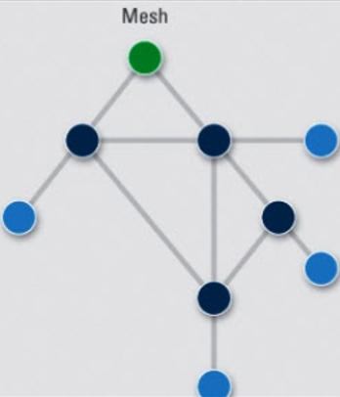
Mesh Topology
Nodes are interconnected, allowing multiple paths for data transmission.
Each node communicates with other nodes within its radio transmission range.
Data can travel directly between nodes within range.
For nodes out of range, intermediate nodes act as relays to forward messages.
Advantages:
Fault Isolation
Reliability
Scalability
Ideal for environments where reliability and
fault tolerance are critical, such as IoT networks, military communication,
and disaster management systems.

Slide 29
The primary goals of WSN security are to ensure
1
2
3
Confidentiality
Integrity
Authenticity

Slide 30
Some key practices for securing a WSN include:
1
Encryption
2
Node authentication
Access control
3
4
Physical security
5
Regular updates

Slide 31
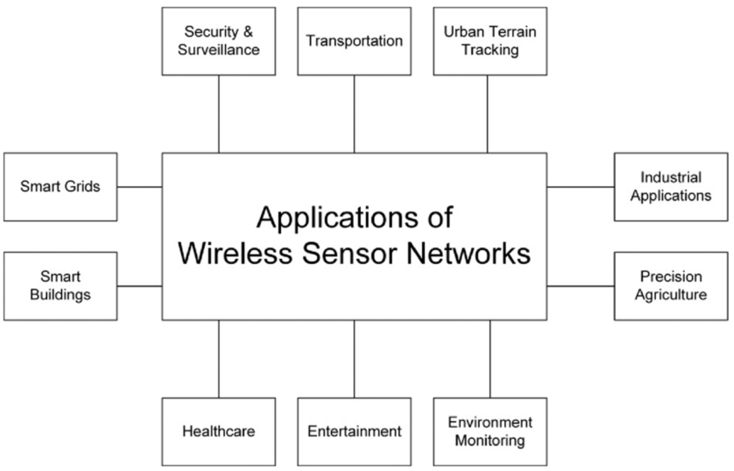

Slide 32
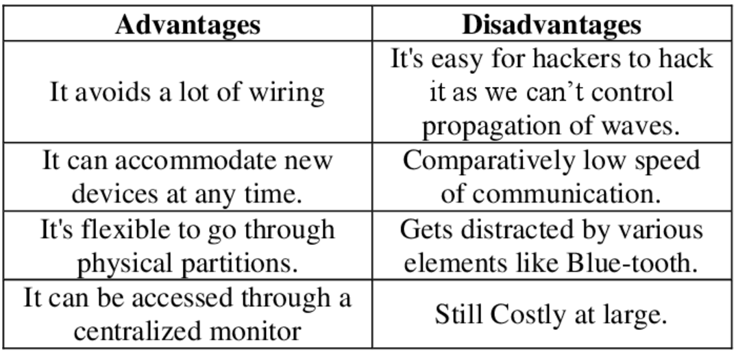
Advantages and Disadvantages of WSN

Slide 33
QUESTION
Discuss how the choice of topology in a Wireless Sensor Network (WSN) impacts its security. Include examples of potential vulnerabilities and corresponding countermeasures for different topologies

Slide 34
Thank you!

